Slide 1
Freddie Mac Residential Mortgage Delinquencies
DS 51110 Fall 2021
Thomas Butler, Andrej Erkelens, Matt Suozzi
Notes:
Hi this is our presentation on Freddie Mac Residential Mortgage Delinquencies, I am Thomas and my teammates are Andrej and Matt. This is our presentation on predicting if single family housing loans will go delinquent, or if a loan will fall behind on payments.

Slide 2
Executive Summary
The Federal Home Loan Mortgage Corporation, also known as “Freddie Mac”, is a government-sponsored enterprise that provides a secondary market for residential mortgages. The organization effectively increases the money supply that mortgage lenders have to issue new loans, by buying mortgages, packaging them into mortgage-backed securities, and then selling them to private investors.
Goal: Predict loan delinquencies
Future Goal: Maximize Profit and Minimize Losses
Think “The Big Short” - Freddie Mac and Fannie Mae were both at the epicenter of 2008-09 housing bubble.c
Notes:
We have created models on single family home loan from Freddie Mac's database to predict loan delinquencies. The models are good but with more data they would be better. With this data we could made new models to create a program which determines our expected profit or loss from a loan.

Slide 3
Data - Origination
Size: 4,413,854 rows, 31 columns
Quantitative Features: Credit Score, Original Combined Loan-to-Value, Original Debt-to-Income (DTI) Ratio
Categorical Features: First Time Homebuyer Flag, Occupancy Status, Loan Purpose
Data features have not changed since 1999, but some underwriting risk standards have changed
Notes:
Freddie Mac has published data each quarter for residential mortgage underwriting criteria at origination, and the subsequent payment history since 1999.

Slide 4
Data - Performance
Size: 53,024,475 rows, 31 columns
Response Variable: Loan Status Classification
Other variables for future work: Loan Age, Remaining Months to Legal Maturity, Actual Loss
Matching problem - one loan from Origination file could map to multiple classifications in the Performance file
Notes:
Payment history was available through Q1 2021 for all mortgages.

Slide 5
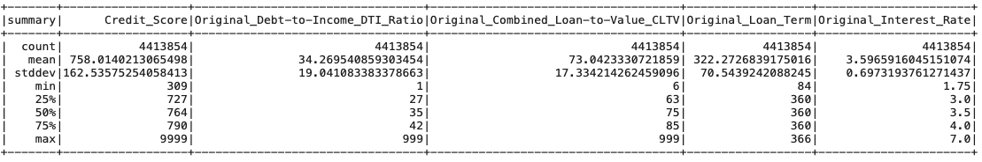
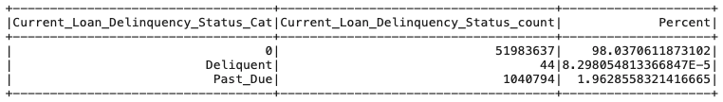
Before Data Cleaning…
Values indicate errors or missing values, not actual credit scores or loan ratios.
Count of loan status exceeds the number of loans made.
Notes:
Create graphs

Slide 6
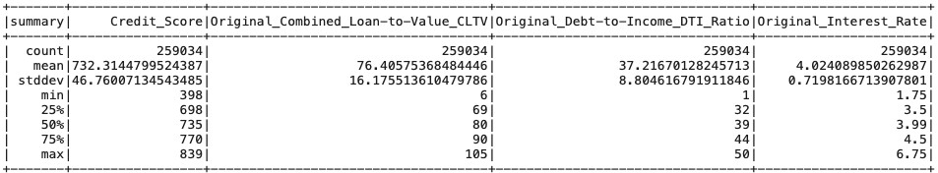
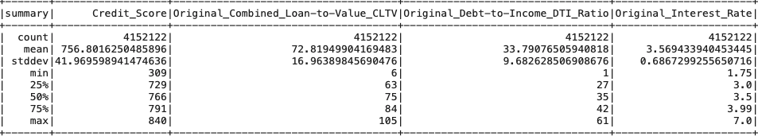
After Data Cleaning…
For delinquent loans:
For current loans:
Notes:
4,411,156 total loans (dropped ~2,700 unique loans due to missing data). 259K delinquent -> 5.9% rate.
Loans that were delinquent had lower credit scores, higher LTVs, and charged higher interest rates by 50 bps.

Slide 7
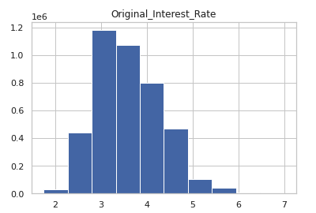
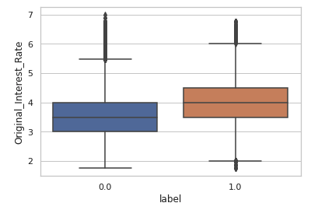
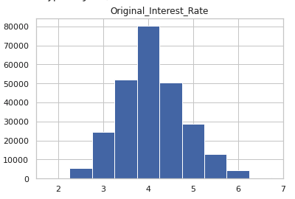
Effectively, interest rate is an engineered feature that combines other metrics, since the underwriter priced and structured the loan based on the risk.
Current Loans
Interest Rate
Delinquent Loans
Current
Delinquent
The boxplot shows that the median interest rate for delinquent loans is about 50 bps higher than the median interest rate for current loans.
The left histogram shows the distribution of interest rates for current loans, and the right histogram shows the distribution of interest rates for delinquent loans. The histogram for current loans is skewed to lower interest rates, while the histogram for delinquent loans is balanced.
Notes:
Raises question if risk is priced accurately or if loans are priced to fail -> self-fulfilling prophecy
Used as single feature in baseline logistic regression model

Slide 8
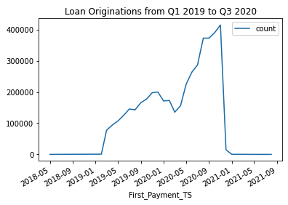
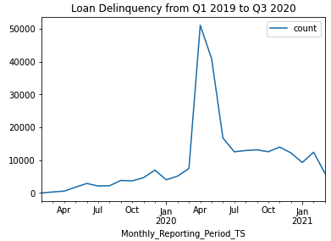
The data set combined quarterly files from Q1 2019 through Q3 2020, with loan payment history and delinquency status as of Q1 2021.
January 1, 2019
mid-March 2020
September 30, 2020
Notes:
For the project, we selected origination data from Q1 2019 through Q3 2020 to explore the impact of the Covid-19 pandemic on origination activity, shifting demographics, and delinquency rates.

Slide 9
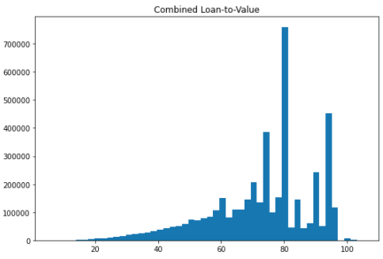
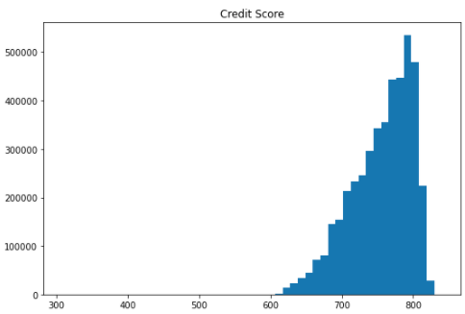
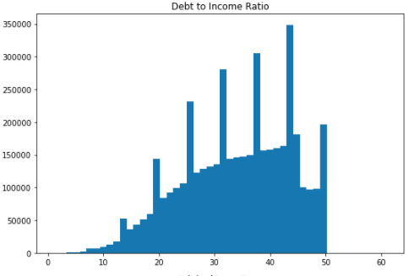
Exploratory Data Analysis
Notes:
Create graphs

Slide 10
Data Pre-Processing/Pipeline
No duplicate loans
Downsampled data from 94-6% split to 50-50% split
Collapse response variable into binary classes
Bucketize Credit Score to turn into FICO Score
StringIndexer and OneHotEncoder on Categorical Variables
MaxAbsScaler on Quantitative Variables
CV on Logistic Regression Models, Random Forest and Gradient Boosted Trees (plus a holdout set)
Notes:
We processed the data into models as shown above. We removed duplicate loans, downsampled the data into a 50-50% class split, collapsed the response variable into a binary one, bucketed credit score into FICO Score, One Hot encoded categorical variables, Scaled the Quantitative Variables so they were between -1 and 1 and cross validated our models to determine optimal hyperparameters of our models.

Slide 11
Model Evaluation
Model | Logistic Regression (Champion Model) | Random Forest (CV) | Gradient Boosted Trees
AUROC | 71.4% | 70.9% | 71.8%
F Score | 0.524 | 0.5392 | 0.782
Precision | 7.87% | 7.97% | 10.8%
As you see all our models have very similar AUROC so we don’t have a Champion Model.
Overall our models were good but could be better.
Notes:
Here are our metrics for our models. All our models are very similar in values so we don’t have a champion model, they all perform about evenly.

Slide 12
Future Work
Expected Profit = Expected income from this loan*Likelihood of this occurring -
Expected loss if loan is delinquent * Likelihood of this occurring
Create multiple models to determine expected profit on loan.
-Have to estimate if a loan defaults when it is most likely to model expected $ lost and expected income
-Have to model expected income from loan if it fully completes
-Can add a safety factor or threshold where the profit has to exceed either a flat amount and/or a percentage of calculated loss.
Notes:
Here is how we would estimate expected profit of a loan. We would create a model which determines likelihood of the loan being paid and another model which calculates expected profit if the loan completes and expected loss at the estimated time period it fails. A safety factor could be created where if the expected profits exceed a certain amount the loan is accepted. This safety factor can either be a flat amount on each loan, like $1,000 in profit, or a percentage over the calculated loss. Best case scenario would include both of these and the program should say which safety factors the loan does or doesn’t pass and expected profit from loan.

Slide 13
Conclusions
To improve the model in the future…
Step 2: Predict time to default - Average Loan Age at time of delinquency
Step 3: Predict Loss Given Default - Average Loss on delinquent loans
Overall our models are useful but they allow lenders another tools or guidelines on if a loan should be given.
Notes:
So to complete our future work we will have to complete both Step 2, predict time to default and Step 3, predict loss given default. Then evaluate our work and see where to proceed.
In the end, our models are useful but they are not the only metric a loan should be measured by, they are just a tool that allow lenders to decide if loans should be given.

Slide 14
Thank You!
Questions?
Notes:
Thank You!

